Slide 1
Osmosis Bringing ideas closer
Introduction

Slide 2
What is Osmosis
A platform where organizations are able to discover and engage the services of other organizations or individuals
Osmosis is a platform where users are able to discover and exchange ideas with organizations or individuals.
Previously…
Now,

Slide 3
Why change?
In a Harvard Business Review article published earlier this week, innovation consultant and author Scott Anthony foretells a so-called “fourth era of innovation” in which big companies – perceived for decades as being too slow and bureaucratic to come up with fresh ideas – will lead the way.
Notes:
While there is agreement that generating ideas from within the organization is a good thing, the hierarchy often suppresses the innovative spirit. It takes specific and concerted efforts to overcome the pervasive force of a bureaucracy.

Slide 4
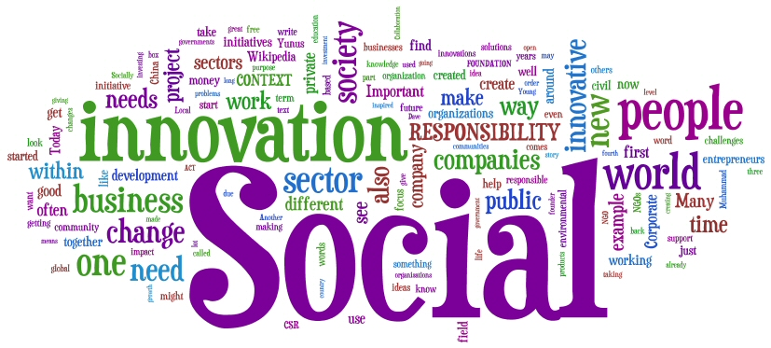
Key Focus of Osmosis
Encouraging Bottom-Up Innovations by connecting individuals with organizations

Slide 5
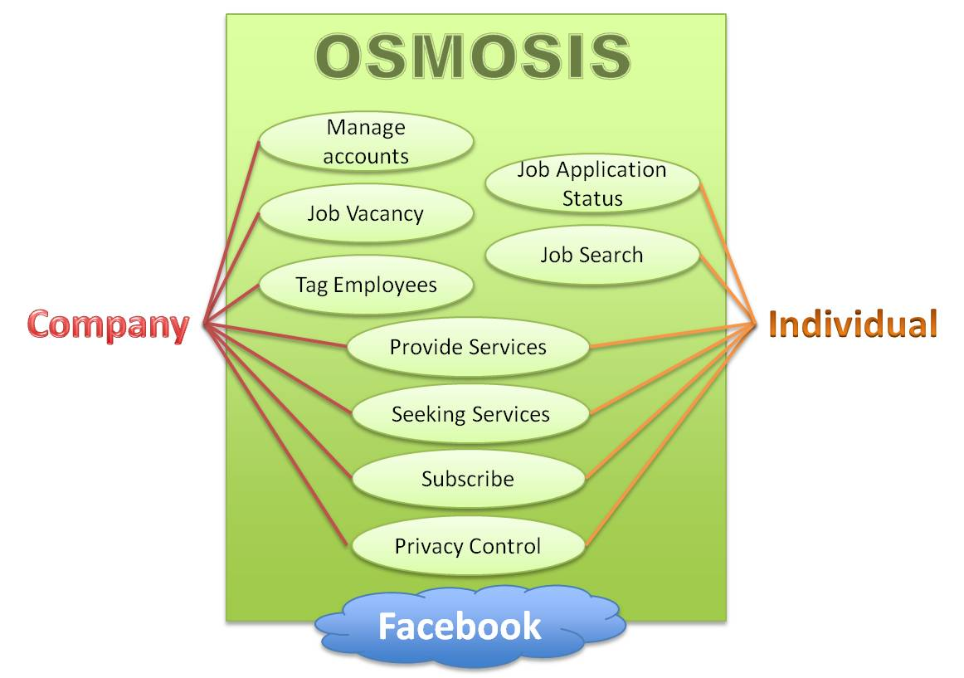
What’s the difference?
Notes:
In essence, there is no difference between the two approach as both will get us to the intended idea or benefit

Slide 6
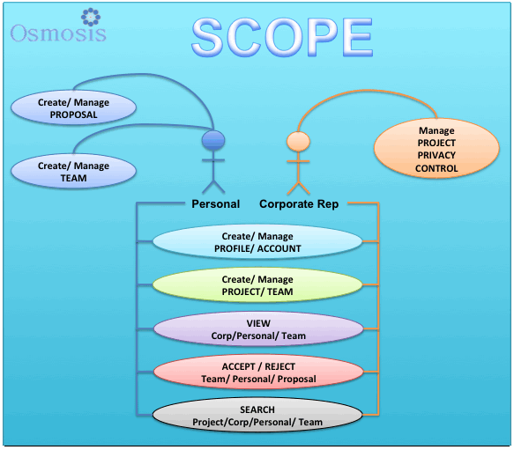
Project Scope

Slide 7
Connecting in 4 simple steps
Create a
Profile
Form a
Team
Propose or
Accept
a Project
Complete a
Project

Slide 8
Features of Osmosis
Maintaining Company/Individual Profile
Create Teams
Create Projects
Propose Project
Search functions
Notes:
User Profile
What would it be used for?
The profile can be used as a tool to help connect with like minded people or simply a tool to market yourself to potential l clients.

Slide 9
Business Value to Great Eastern
Encourage Bottom-Up Innovations within the
organisation by connecting with its employees
A platform that foster greater cooperation and
Communication between employees across departments
Connect with a pool of talented individuals from all
Over the world
A new form of advertising to market the
competencies and capability of its employees

Slide 10
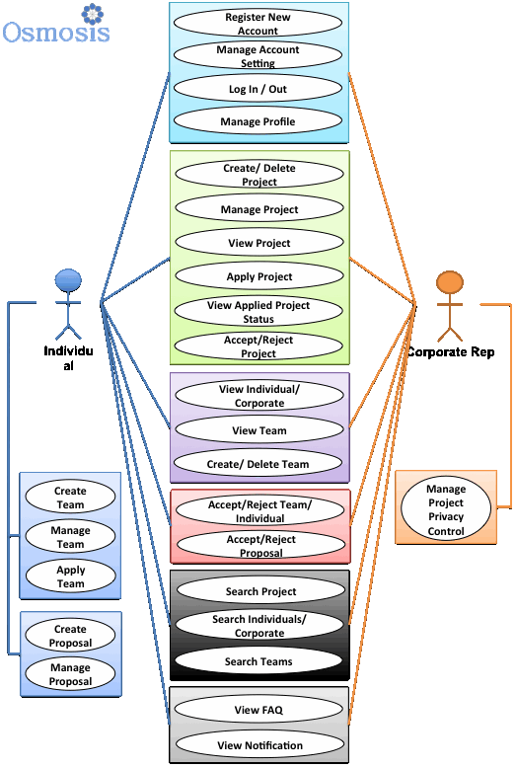
Use Cases

Slide 11
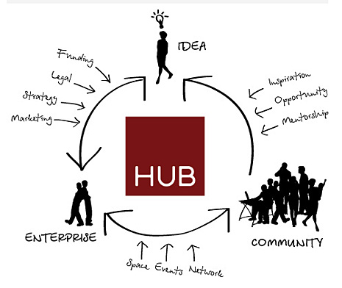
Future of Osmosis

Slide 12
Thank You!

